Slide 1
KILL-SWITCH FOR SHADOW AI
Browser-Integrated Data Loss Prevention for AI Interactions

Slide 2
01
04
Introduction
Objective
02
05
What is Shadow AI
Proposed Solution
03
06
Problem Statement
System Architecture
TABLE OF CONTENTS

Slide 3
07
10
Key Features
Conclusion
08
Technology Stack
09
Example
TABLE OF CONTENTS

Slide 4
Introduction
AI tools like ChatGPT are widely used in workplaces.
Employees often use unauthorized AI tools.
This creates Shadow AI risks.
Sensitive company data may be exposed unintentionally.

Slide 5
What is Shadow AI
Shadow AI refers to the use of AI tools
without approval from the organization.
Employees may unknowingly expose:
• Internal company data
• Credentials or API keys
• Customer information

Slide 6
Problem Statement
Sensitive information is often pasted into AI prompts. Examples include: • API keys • Personal Identifiable Information (PII) • Confidential company data • Trade secrets This data may be stored or used to train AI models.

Slide 7
Objective
Our objective is to create a security layer for AI interactions.
Detect sensitive information
Automatically redact it
Prevent confidential data leakage

Slide 8
Proposed Solution
We propose a browser-based security extension
that monitors AI interactions.
The extension will:
• Capture prompts before submission
• Scan for sensitive patterns
• Automatically redact confidential data

Slide 9
System Architecture
Detection engine scans for sensitive data
User enters prompt in AI chatbot
Safe prompt is sent to AI model
Browser extension intercepts prompt
Redaction module removes confidential data

Slide 10
Key Features
• Real-time prompt monitoring
• Automatic data redaction
• Detection of API keys and credentials
• Custom security rules
• Logging and monitoring

Slide 11
Technology Stack
Frontend • Browser Extension (JavaScript) Backend • Python / Node.js Detection Engine • Regex pattern matching • Machine learning models Database • Secure logging system

Slide 12
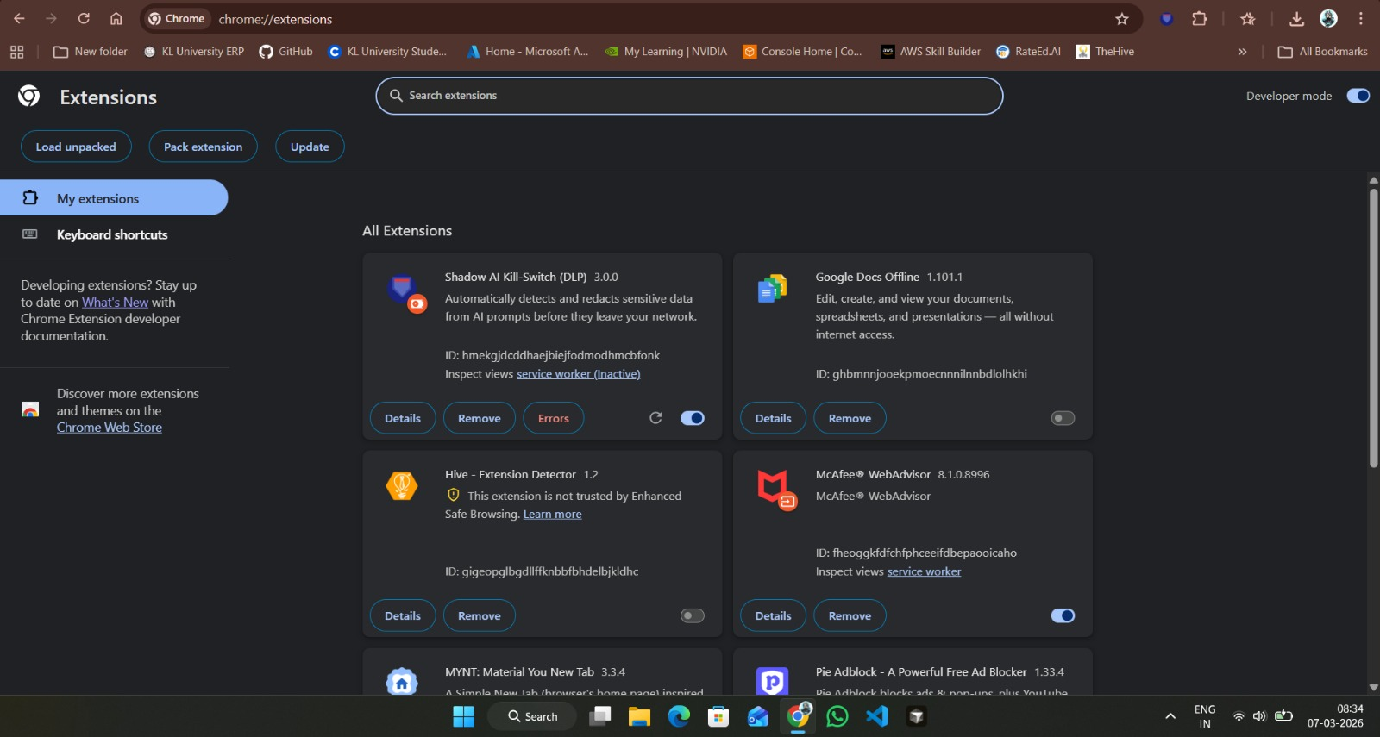

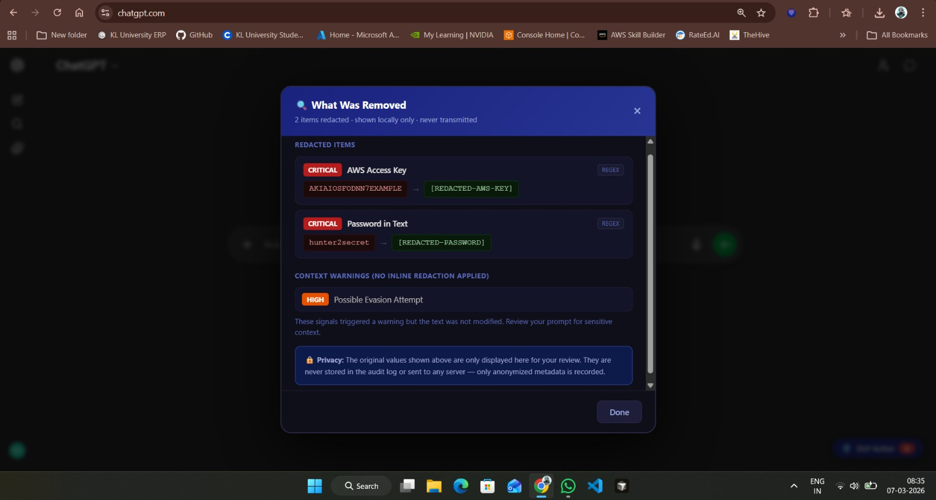
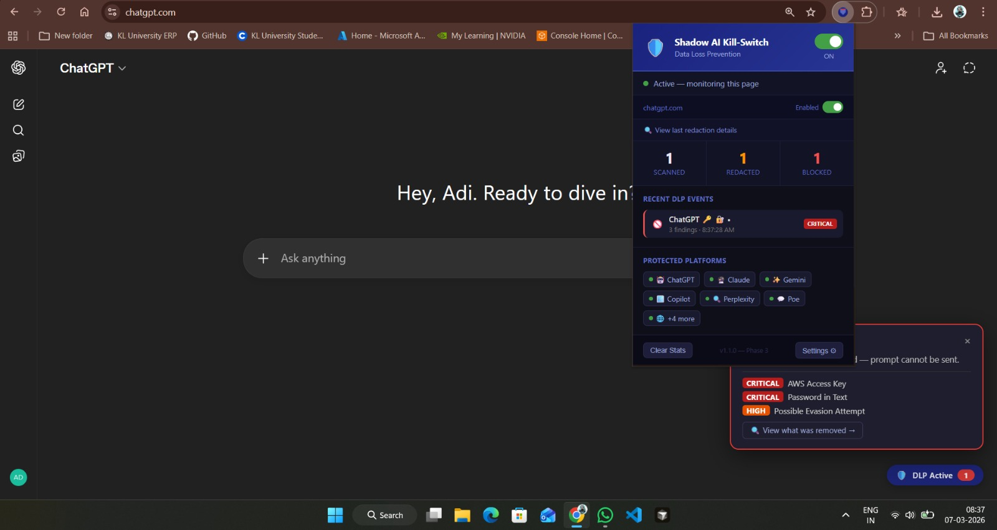
Example

Slide 13
Conclusion
Shadow AI is a growing cybersecurity challenge.
Our solution provides a proactive
security layer for AI interactions.
It ensures that organizations
can safely adopt AI technologies.

Slide 14
Thankyou!
Presented by :- Agastya Singh Challa Saketh Kumar Marisa Aditya Vardhan

